Slide 1
Hacking (Please see slide notes for presentation content)
What is it?
Notes:
You may have heard clients expressing the concern that they have been hacked.
Ask the crowd – address this topic in terms of what they say – “Can anyone tell me what in this context hacking means?”
While hacking can be used for several nefarious purposes, what you/we are mostly talking about is the de-privatization of personal data. Be that personal location, your Instagram DMs, or access to your bank account.
“So how is that data gotten?” (this question may not need to take answers from the crowd cuz they probably don’t know)
Most successful hacks do not need advanced technical skills. hackers frequently rely on simple schemes to trick people into giving up their passwords, emails, and other private information. This becomes even more possible with physical access to the device, as is the case with many domestic violence situations.
They call your work, ask for you at a time when you are not in, and then ask what your schedule is.
They can send an email that looks like it is from your mom, and you log in with your password to Instagram to respond – but it is a fake log in and now the email sender has your password which may be the same as other passwords.
In domestic violence situations, they can force you through threat of violence to give them your phone password and install stalkerware that monitors all of your digital behavior
(I would consider all of these hacks, even though the first is often thought of as simply “stalker behavior”)
The uniqueness of the domestic violence situation is that in many cases the “hacker” may have physical access to your device. This is a threat scenario that is usually excluded in information security.

Slide 2
Threat Modeling
• What do you want to protect?
• Who do you want to protect it from?
• How likely is it that you will need to protect it?
• How bad are the consequences if you fail?
• How much trouble are you willing to go through in order to try to prevent those?
https://libraryfreedom.org
Notes:
How do infosecurity ppl talk about technical concerns
Threat modeling is a system for how we can talk about an individuals concerns before they become instituted.
With these five questions we can create an action plan for any number of scenarios.
Lets look at an example

Slide 3
I don’t want my abuser to be able to find me
• What do you want to protect?
My location
• Who do you want to protect it from?
My abuser
• How likely is it that you will need to protect it?
I don’t know
• How bad are the consequences if you fail?
terrible
• How much trouble are you willing to go through in order to try to prevent those?
I am willing to partially remove social occurrences from my life
https://libraryfreedom.org
Notes:
This is a simple example that shows generally where you will need to focus your effort
Identifying how likely different scenarios are (third bullet)
Navigating the safety planning element (fourth bullet)
Understanding that there is an additional loss of freedom associated with changes (fifth bullet)
using the example here, some people may be willing to delete their Instagram and some may not and we need to accept that and use their levels of comfort to craft a plan of what can be done and what cannot

Slide 4
Lets create a scenario together
• What do you want to protect?
• Who do you want to protect it from?
• How likely is it that you will need to protect it?
• How bad are the consequences if you fail?
• How much trouble are you willing to go through in order to try to prevent those?
https://libraryfreedom.org
Notes:
This exercise is to help the presenter gain an understanding of what this shelter is dealing with
Say that so that they know what you are trying to accomplish and encourage them to give you a scenario they have had before.

Slide 5
My abuser is following me
• They always know my location, even when I try to hide it
• They work with computers
• They have shown up numerous times
• I am scared
• I don’t want to give up my Instagram or facebook
https://libraryfreedom.org
Notes:
This slide just gives another example for if you need more to discuss specifically with the second bullet point
It is important to try and figure out what level of tech skills the abuser has or what level of money since those can make
more serious problems (i.e. root access, jailbreaks, or remote access to computers) more likely.

Slide 6
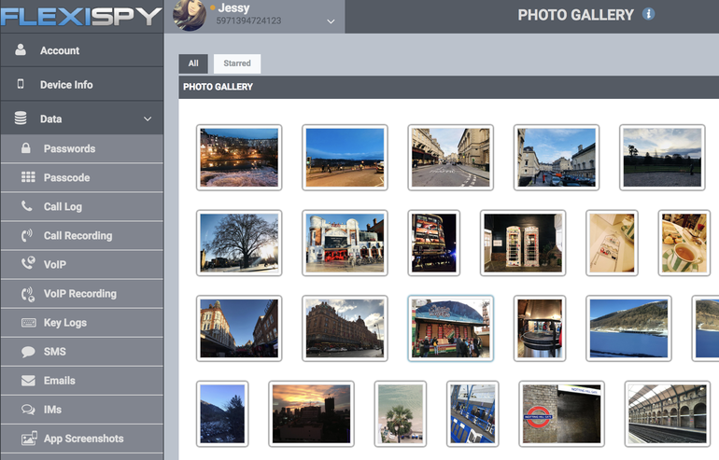
Stalkerware
https://libraryfreedom.org
Notes:
Explain what stalkerware is, which companies provide it, why there are so many of them, how they are marketed
Explain what they can access and how that changes with money spent
Emphasize that the abuser must have physical access to the device and will need the password to the device to be able to install this.
I got a lot of questions about the IT aspects of this – like how it is working and if they need to be scared about their network

Slide 7
What can be done to protect yourself
• For location based monitoring, turn off all location services on your smartphone
• For identity theft concerns, learn how to avoid common digital pitfalls
• For password hacking, use a password manager and 2 factor authentication
• For advanced hacking, update your software and utilize all mentioned above
• Extreme caution, use a VPN or only access the web via TOR browser
https://libraryfreedom.org
Notes:
This is preemptive to exposure to stalkerware. If stalkerware is found and the device can be identified as not jailbroken or rooted then
Reseting to factory and only restoring photos and contacts is possible.
If jailbroken or rooted throw the phone in the nearest body of water.

Slide 8
How protected is CSN? (Name of Shelter)
• Do you all have any concerns about someone hacking your own network?
• Do you give the network access to clients?
• How is your IT infrastructure handled?
https://libraryfreedom.org
Notes:
This is here to try and make them feel more comfortable about their set up.
The shelter I was with was very concerned that this could be their fault and so a lot of this talk was explaining
How hacking could work on a local network and why that is generally unlikely – this will depend on their IT architecture
If they are running a server with remote services and connecting clients to that same network there is some possibility of hacking
But this wasn’t the case for me
This slide is not 100% necessary so if you don’t feel comfortable talking about IT infrastructure feel free to delete it.
Just say that the most likely avenue for attack from an abuser is going to be through direct interaction with their device
And that while theoretically there is some possibility of targeted hacking it would not be the first mechanism that an attacker employs.

Slide 9
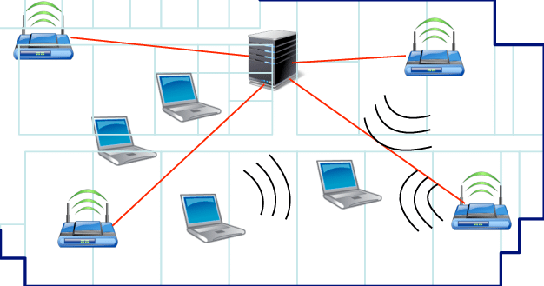
Network Diagram
https://libraryfreedom.org
Notes:
From discussion before there is the local network map to explain why it is more likely that the attack would be from the person’s device.

Slide 10
What options do you have?
Train staff to be able to deal with these problems and to recognize when the problem is too advanced for them to deal with
2. Coordinate with an outside individual to have them meet with clients and audit their devices.
https://libraryfreedom.org
Notes:
This is where you talk about what the next steps are.

Slide 11
Are there concerns you have for clients that we have not addressed?
https://libraryfreedom.org
Notes:
That’s it.

