Slide 1
Shared Media Time to Promote Positive Behaviors
Notes:
“Hi so I am here today to talk a bit about the technology kids use how to support them in a mutually beneficial way”
“A little about me – I love my phone and I hate technology companies. I’m on the research team here at the library – and I enjoy looking at academic articles.”
“to me it seems that Parents are often exposed to everything bad that technology use has to offer.”
“I am here to show a little bit of the other side”
But remember I still hate technology companies
“That isn’t to say that the bad things you hear are untrue just that we can find positive aspects to technology”

Slide 2
Notes:
“Lets briefly compare some articles to some of the available academic literature.”

Slide 3
Playing video games mimics the kinds of sensory assaults humans are programmed to associate with danger. When the brain senses danger, primitive survival mechanisms swiftly kick in to provide protection from harm. This response is instantaneous; it is hardwired in our genes and necessary for survival. Keep in mind that the threat does not have to be real — it only needs to be a perceived danger for the brain and body to react.
Notes:
“here is quote from the article, and what I would like to make apparent is the confident and declarative nature of all the statements”

Slide 5
Current results suggest that pathological gaming arises from attention problems, but not the inverse. These results suggest that pathological gaming behaviors are symptomatic of underlying attention related mental health issues, rather than a unique phenomenon.
Notes:
Take notice here the use of the term “Suggest” and the cautious voice used to demonstrate their findings.
The point I am trying to make here is that the hyperbolic nature of web articles in comparison to
academic articles distorts the level of confidence that one should attribute to the data”
Even among academics there is conflicting data.
which makes it harder as a parent to know if the right course of action is to eliminate this source (i.e. video games or social media) or to put work into changing the underlying behavior” “The latter is objectively more difficult, but doesn’t have to be a terrible experience

Slide 6
Notes:
Shared media time
positively predicted physical contact, which in turn positively predicted parent-child closeness.
Shared video-game play positively predicted strategy talk, which positively
predicted both outcomes.
Shared video-game play positively predicted strategy talk, which positively
predicted both outcomes.
“ I would go a step further and suggest that parents can actively mitigate concerning behaviors in their children through project based parent-child activities.”
“when I look back on what I wanted as a child it was help finishing projects – I would read lots of forums about things like making a bow and arrow and then as I was working on them I would get too enthralled by the prospect of finishing and I would cut corners and the end result would be unappealing – what I wanted was someone to progress through the project with me and guide me”

Slide 7
Notes:
So, what are some actions parents can take to mitigate

Slide 8
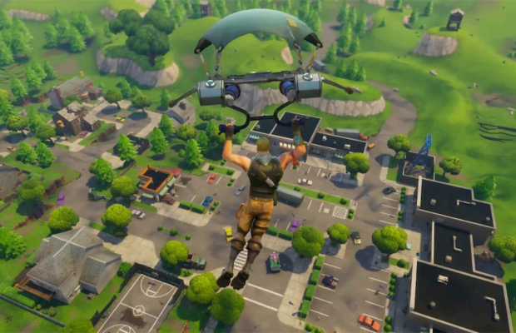

Slide 9
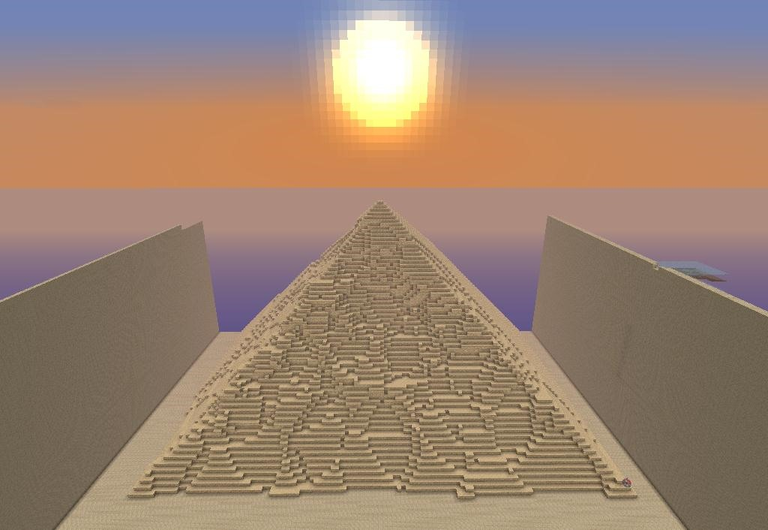

Slide 12
Conclusion:
Find out what your child gains from use of an application.
Promote the behaviors you want in your child with the applications they enjoy.
Mitigate the negatives of technology use by finding mechanisms for mutual participation.

